Slide 1

Getting started
Lesson 6: Impossible photographs

Slide 2
Objectives
In this lesson you will learn how to:
use image editing software to create an impossible photograph
use your image editing skills to create impossible creatures.

Slide 3
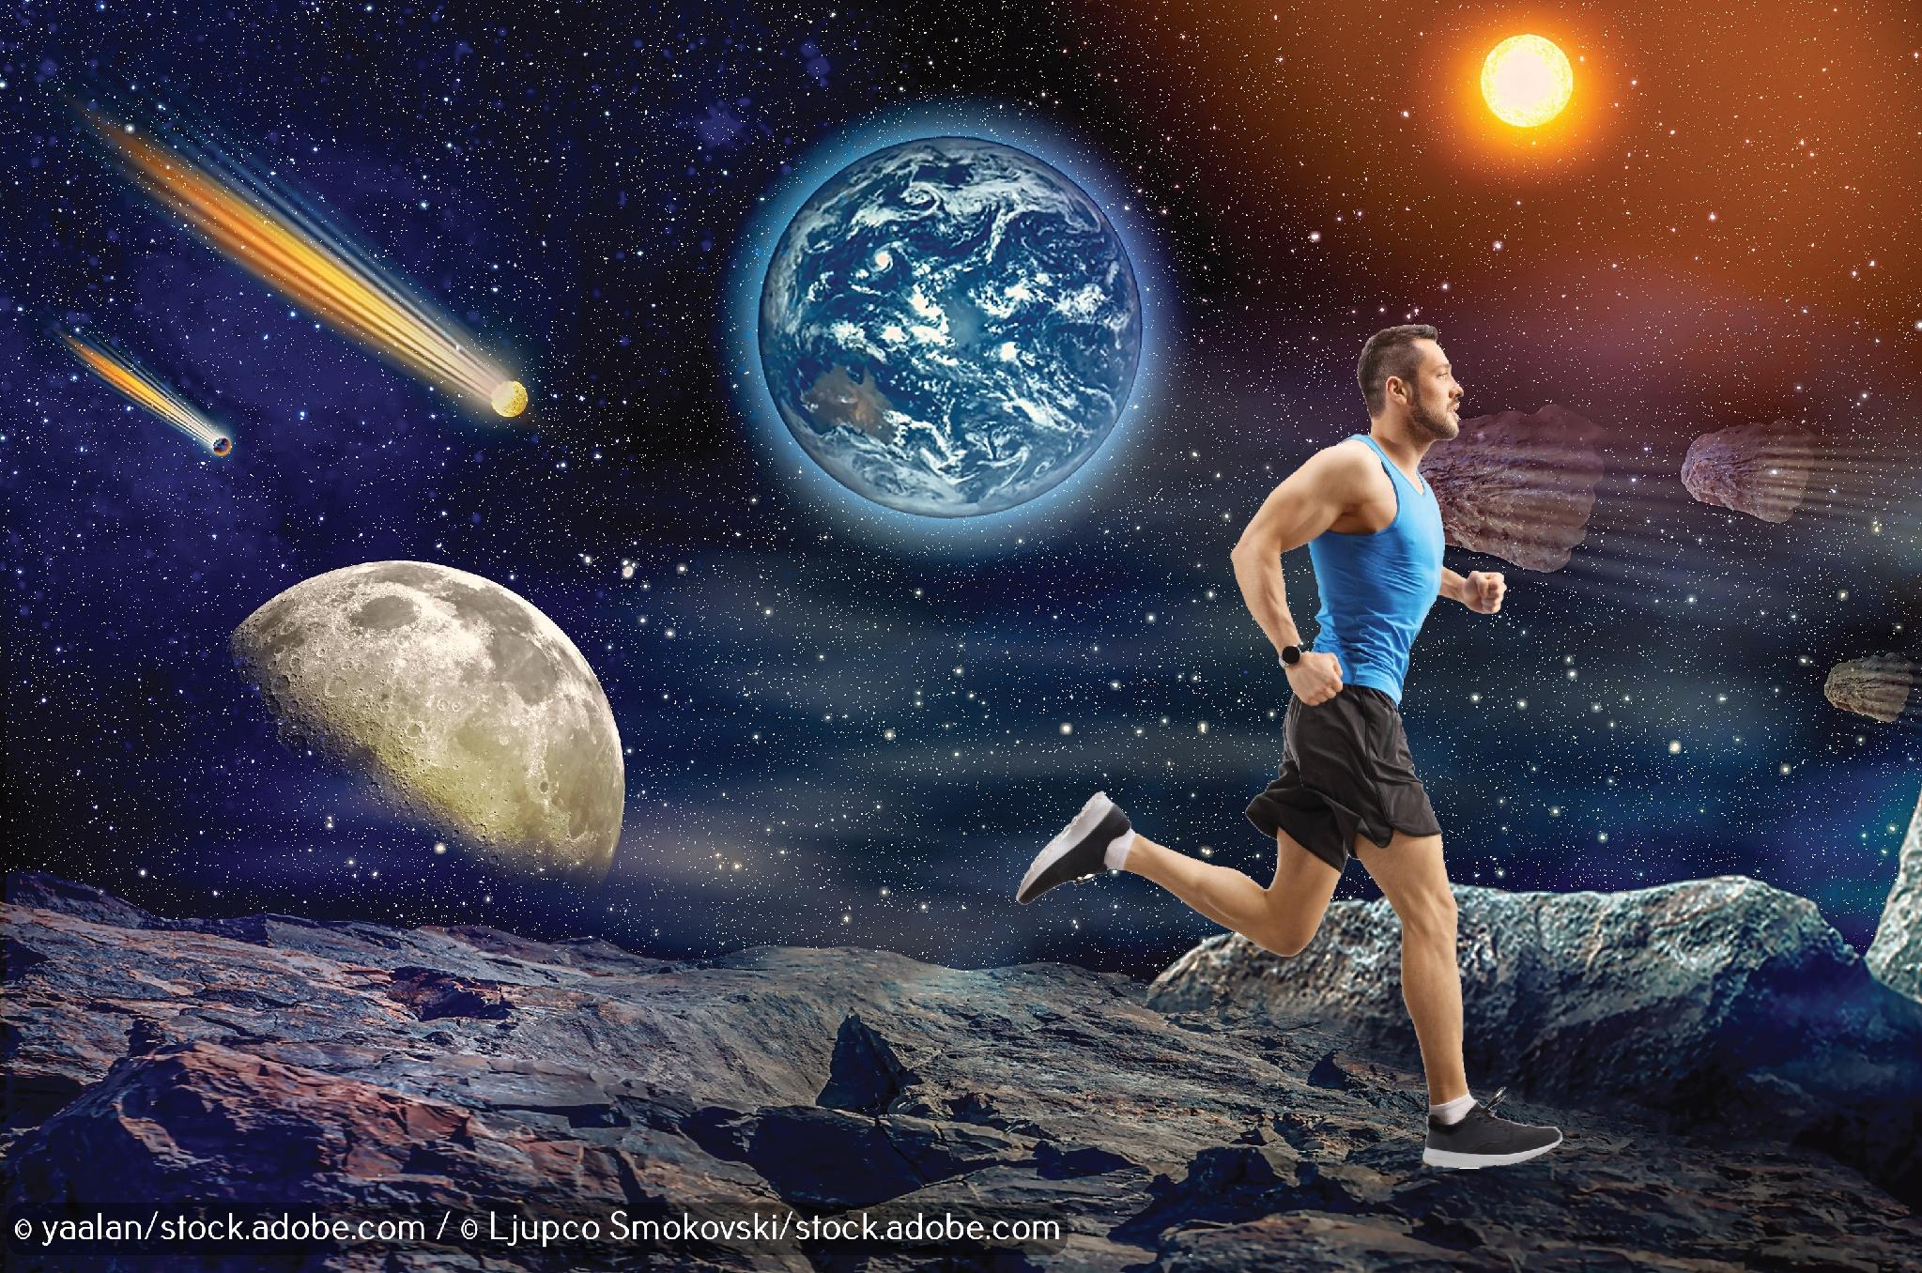

Slide 4
Inserting a cut-out into a new backgound
Open GIMP and then:
select and save a background image
copy your cut-out into the new background layer.
Once you have created your final image, you can export it and save it as a .png file to be used in other software.
Now watch Video 6.1

Slide 5

Activity 6.1: Inserting a cut-out into a new background

Slide 6
Activity 6.2: Impossible creature
Your final challenge is to use your image editing skills to create an impossible creature, just like the one in the photograph.
You will need to use the 'Rectangle Select Tool' to select part of each animal.
You will need to use the 'Scale Tool' to match the parts of the two animals together.

